Slide 1
Naïve Bayes Classifier
Thuc Le
Advanced Analytic Techniques 2
University of South Australia
(The slides are based on Naïve Bayes Classifier of Ke Chen, University of Manchester)

Slide 2
Outline
Background
Probability Basics
Probabilistic Classification
Naïve Bayes
Principle and Algorithms
Example: Play Tennis
Relevant Issues
Summary

Slide 3
Classification
Email: spam/not spam
Clinical data: cancer/normal
Transaction: fraudulent/normal
C{0,1} 0: negative class
1: positive class

Slide 4
Background
There are three methods to establish a classifier
a) Model a classification rule directly
Examples: k-NN, decision trees, perceptron, SVM
b) Model the probability of class memberships given input data
Example: perceptron with the cross-entropy cost
c) Make a probabilistic model of data within each class
Examples: naive Bayes, model based classifiers
a) and b) are examples of discriminative classification
c) is an example of generative classification
b) and c) are both examples of probabilistic classification

Slide 5
Probability Basics
Prior, conditional and joint probability for random variables
Prior probability:
Conditional probability:
Joint probability:
Relationship:
Independence:
Bayes Rule

Slide 6
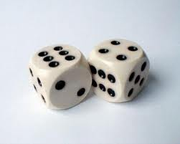
Probability Basics
Quiz: We have two six-sided dice. When they are tolled, it could end up with the following occurance: (A) dice 1 lands on side “3”, (B) dice 2 lands on side “1”, and (C) Two dice sum to eight. Answer the following questions:

Slide 7
Probabilistic Classification
Establishing a probabilistic model for classification
Discriminative model
Discriminative
Probabilistic Classifier

Slide 8
Probabilistic Classification
Establishing a probabilistic model for classification (cont.)
Generative model
Generative
Probabilistic Model
for Class 1
Generative
Probabilistic Model
for Class 2
Generative
Probabilistic Model
for Class L

Slide 9
Probabilistic Classification
MAP classification rule
MAP: Maximum A Posterior
Assign x to c* if
Generative classification with the MAP rule
Apply Bayes rule to convert them into posterior probabilities
Then apply the MAP rule

Slide 10
Naïve Bayes
Bayes classification
Difficulty: learning the joint probability
Naïve Bayes classification
Assumption that all input features are conditionally independent!
MAP classification rule: for

Slide 11
Naïve Bayes
Algorithm: Discrete-Valued Features
Learning Phase: Given a training set S,
Output: conditional probability tables; for elements
Test Phase: Given an unknown instance ,
Look up tables to assign the label c* to X’ if

Slide 12
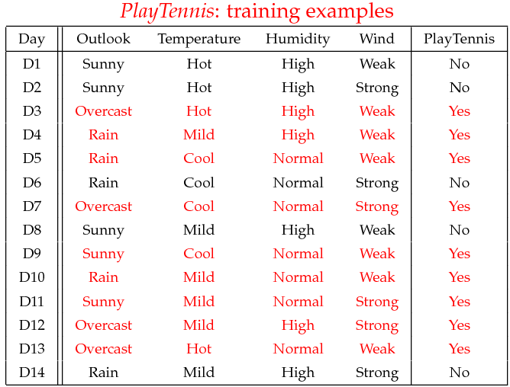
Example
Example: Play Tennis

Slide 13
Example
Learning Phase
P(Play=Yes) = 9/14
P(Play=No) = 5/14
Outlook | Play=Yes | Play=No
Sunny | 2/9 | 3/5
Overcast | 4/9 | 0/5
Rain | 3/9 | 2/5
Temperature | Play=Yes | Play=No
Hot | 2/9 | 2/5
Mild | 4/9 | 2/5
Cool | 3/9 | 1/5
Humidity | Play=Yes | Play=No
High | 3/9 | 4/5
Normal | 6/9 | 1/5
Wind | Play=Yes | Play=No
Strong | 3/9 | 3/5
Weak | 6/9 | 2/5

Slide 14
Example
Test Phase
Given a new instance, predict its label
x’=(Outlook=Sunny, Temperature=Cool, Humidity=High, Wind=Strong)
Look up tables achieved in the learning phrase
Decision making with the MAP rule
P(Outlook=Sunny|Play=Yes) = 2/9
P(Temperature=Cool|Play=Yes) = 3/9
P(Huminity=High|Play=Yes) = 3/9
P(Wind=Strong|Play=Yes) = 3/9
P(Play=Yes) = 9/14
P(Outlook=Sunny|Play=No) = 3/5
P(Temperature=Cool|Play==No) = 1/5
P(Huminity=High|Play=No) = 4/5
P(Wind=Strong|Play=No) = 3/5
P(Play=No) = 5/14
P(Yes|x’): [P(Sunny|Yes)P(Cool|Yes)P(High|Yes)P(Strong|Yes)]P(Play=Yes) = 0.0053
P(No|x’): [P(Sunny|No) P(Cool|No)P(High|No)P(Strong|No)]P(Play=No) = 0.0206
Given the fact P(Yes|x’) < P(No|x’), we label x’ to be “No”.

Slide 15
Naïve Bayes
Algorithm: Continuous-valued Features
Numberless values for a feature
Conditional probability often modeled with the normal distribution
Learning Phase:
Output: normal distributions and
Test Phase: Given an unknown instance
Instead of looking-up tables, calculate conditional probabilities with all the normal distributions achieved in the learning phrase
Apply the MAP rule to make a decision

Slide 16
Naïve Bayes
Example: Continuous-valued Features
Temperature is naturally of continuous value.
Yes: 25.2, 19.3, 18.5, 21.7, 20.1, 24.3, 22.8, 23.1, 19.8
No: 27.3, 30.1, 17.4, 29.5, 15.1
Estimate mean and variance for each class
Learning Phase: output two Gaussian models for P(temp|C)

Slide 17

Relevant Issues
Violation of Independence Assumption
For many real world tasks,
Nevertheless, naïve Bayes works surprisingly well anyway!
Zero conditional probability Problem
If no example contains the attribute value
In this circumstance, during test
For a remedy, conditional probabilities estimated with

Slide 18
Summary
Naïve Bayes: the conditional independence assumption
Training is very easy and fast; just requiring considering each attribute in each class separately
Test is straightforward; just looking up tables or calculating conditional probabilities with estimated distributions
A popular generative model
Performance competitive to most of state-of-the-art classifiers even in presence of violating independence assumption
Many successful applications, e.g., spam mail filtering
A good candidate of a base learner in ensemble learning
Apart from classification, naïve Bayes can do more…

Slide 19
Thank You.

